Slide 1
PWM Drawer using Graphical LCD Zeyad Mohmed ElHadidy

Slide 2
Module
MCAL
HAL
APP
Utils

Slide 3
MCAL
DIO
Used to help set pin direction and value and get the pin for pins
Functions used are
DIO_voidSetPinDirection
DIO_voidSetPinValue
DIO_voidGetPinValue
DIO_voidTogglePinValue

Slide 4
MCAL
PWM
Used to initialize and control PWM
Functions used are
PWM_voidInitChannel_0
PWM_voidGenerateOnChannel_0
PWM_voidInitChannel_1A
PWM_voidGenerateOnChannel_1A

Slide 5
MCAL
ICU
ICU is the input capture unit that allows the microcontroller to read the PWM signal
Functions used are
ICU_voidinit
ICU_voidSetEdge
ICU_voidClearTimerReg
ICU_u16GetValue
ICU_GetStatus
ICU_voidGetDuty

Slide 6
HAL
GLCD
Graphical LCD module is used to display the PWM signal on the screen
Functions used are
GLCD_voidInit
GLCD_voidCMD
GLCD_voidData
GLCD_voidSelectPage
GLCD_voidSetCursor
GLCD_voidChar

Slide 7
HAL
GLCD
Functions used are
GLCD_voidString
GlCD_voidSpecialChar
GlCD_voidGoToLine
GLCD_voidClearDisplay
GLCD_voidFloat
GLCD_voidInteger

Slide 8
APP
The APP module contains the function that puts all the previous modules together to make the PWM Drawer.
The user could also chose if the PWM signal and the GLCD is in the same microcontroller or different ones
Functions used are
PWM_Drawer_voidinit
PWM_Drawer_voidMeasureSignal
PWM_Drawer_voidDraw

Slide 9
UTILS
Utils contain STD_type and BITMath which help is simplifying the code and easier to organize.

Slide 10
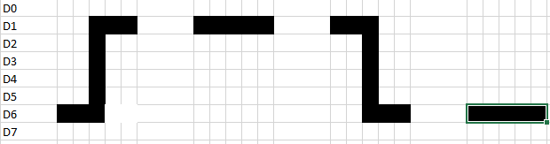
Special patterns on the GLCD

Slide 11
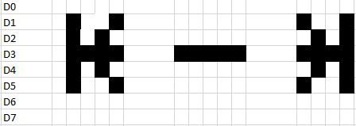
Special patterns on the GLCD

Slide 12
THANK YOU ANY QUESTIONS?

